Slide 1


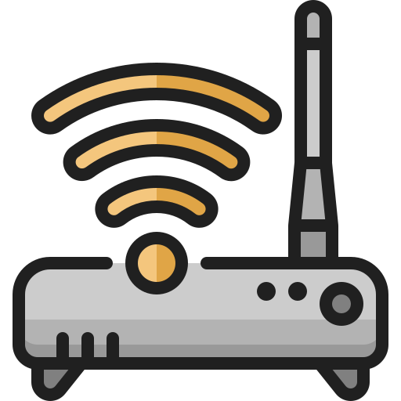
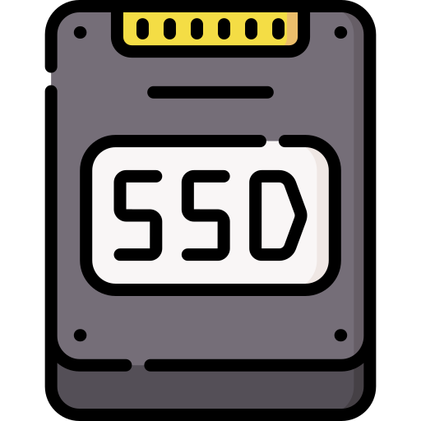
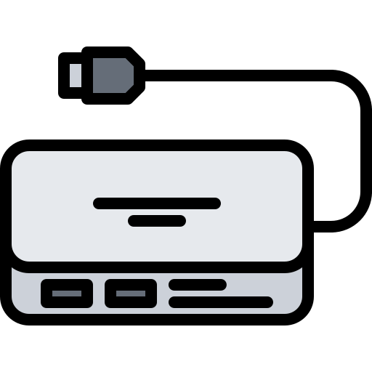
Monitor Arm Tools
Keyboard & Mouse
Equipment
(Router, Switch, ...)
Disk (M.2, RAM,
SSD, HDD, SATA3)
Hub (Extender,
Converter, ...)

Slide 2






Monitor Cable
(DP, HDMI, DVI, RGB)
Power Cable (AC, DC)
Internet Cable
(CAT5E, CAT6)
Material
Tools
Trash

